Slide 1
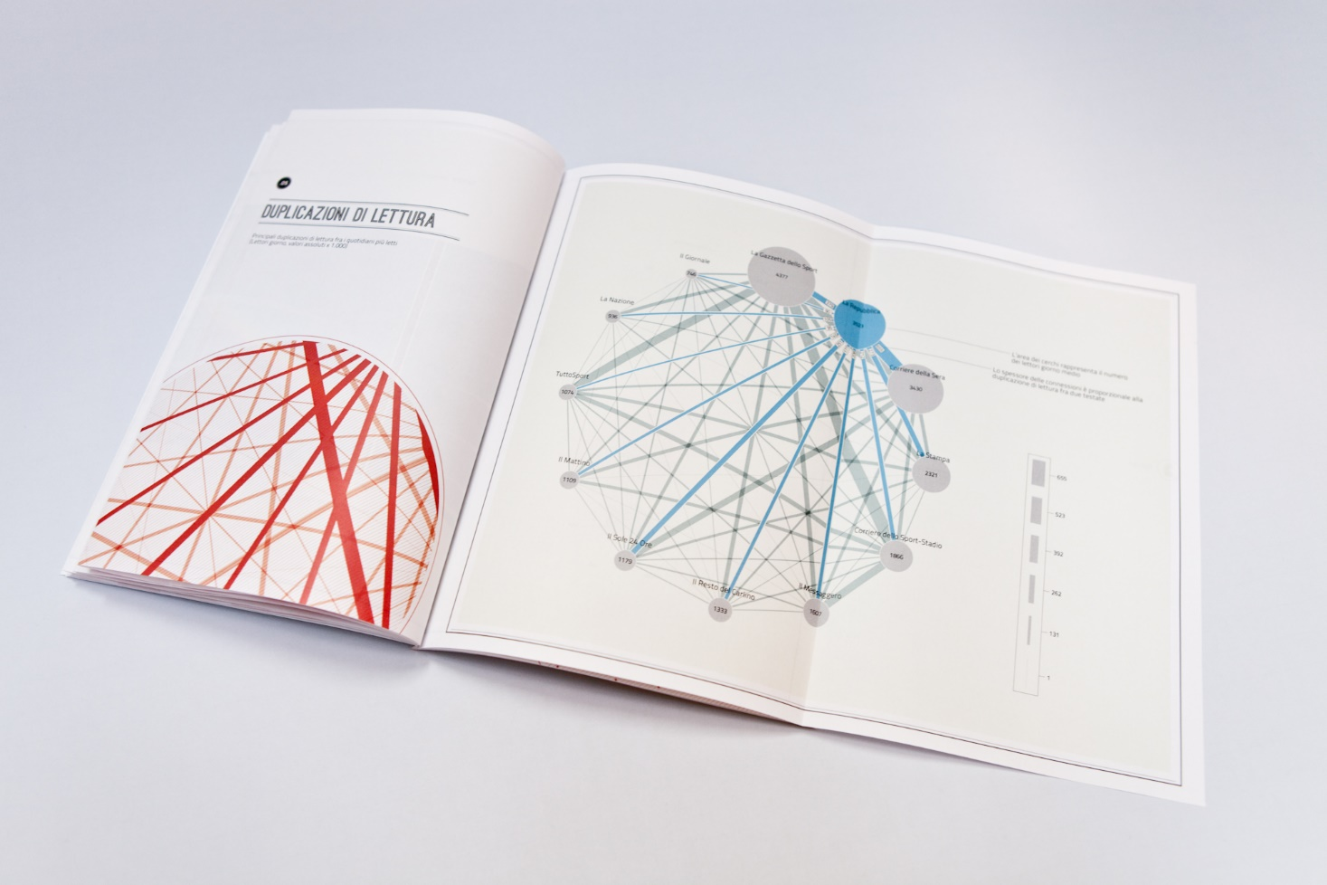
Predicting Performance Using Resumes

Slide 2

Overview
Data & Analysis
3
4
Implications & The Future
Theories
1
2
Methods

Slide 3
The purpose of this research is to see if it is possible
to use the text in resumes to predict job performance

Slide 4
BIODATA
Marker Words
This Research
questions developed and scored to maximize prediction of a business outcome (e.g. job performance)¹
Speech is observable behavior that reflects meaningful psychological traits and characteristics
Three categories²
Classification¹
Developmental experiences³
Typical behavior
Typical job-related behavior⁴
Used to diagnose individuals based on analysis of their speech
A Method
Behaviors and psychological characteristics^{2,3}
An approach to measuring constructs used to predict behavior
Impression management styles² and mood³ have been identified from speech
4 theories underlie this method⁵
The research here was the result of integrating theories and methods from biodata and the marker word hypothesis
Intelligence⁴
Classification
Consistency model
Ecology model of behavior
Social Identity Theory
Differentiation words, conjunctions, words with 6+ characters, prepositions, and cognitive process words may reflect intelligence^{5,6}
Notes:
Becton, et. al., 2009; Cucina, Caputo, Thibodeaux, & Maclane, 2012
Becton, Matthews, Hartley & Whitaker, 2009; Barrick & Zimmerman, 2009; Mael, 1991; Zaccaro, Gilbert, Zazanis, & Diana, 1995
Zaccaro, Gilbert, Zazanis, & Diana, 1995
Barrick & Zimmerman, 2009
Arthur & Villado, 2008
1) Oxman, Rosenberg, Schnurr, and Tucker (1988)
2) Ickes, Reidhead, and Patterson (1986)
3) Nguyen, Phung, Adams, and Venkatesh (2013)
4) Schmidt & Hunter, 2004
5) Tausczik and Pennebaker, 2010
6) Hartley, Pennebaker, & Fox, 2003
Text has been used to diagnose patients.
The text analysis approach yielded correct diagnoses 64 (paranoid disorders) to 100% (somatization disorder) of the time, compared to trained psychiatrists ranging from 52 (paranoid disorders) to 85% (cancer), and diagnosis with assessments ranging from 47 (somatization disorder) to 94% (cancer).
Note: categories from text analysis—distress, lower status, work, self, political, sign ascend, quantity reference
Applies to behaviors and psychological characteristics too. For example, the words people use can indicate they use a self versus other oriented style of impression management. Other-oriented impression management style used more first person pronouns (e.g. “I”, “me”, “we”) whereas individuals with a self-oriented style employed more second and third person pronouns (e.g. “you”, “your”, “he”, “she”). Impression management, is particularly of interest because it has been empirically linked to supervisory ratings of job performance (Wayne & Liden, 1995). [Other: impression management is an end in its own right. Self: impression management is a means to an end.]
Researchers analyzed 600,000 blog posts tagged with moods by the authors. 68 of 80 LIWC categories were used as inputs into a special type of logistic regression (Support vector machines) and were used to predict blog posts into three moods: sad, happy, and angry. After cross-validation accuracy was 74%
GMA is arguably the best predictor of job performance (Schmidt & Hunter, 2004) and demonstrates the highest financial utility (Hunter & Hunter, 1984). Therefore, it is necessary to consider whether intelligence can be derived from the words individuals use and thereby used to predict job performance. Philip E. Vernon’s model of intelligence included a hierarchical grouping of factors with GMA at the top level, and two major sub-factors containing multiple sub-dimensions, including verbal intelligence.
Taking this model of intelligence, it is reasonable to assume that there may be a link between this sub-factor and written and verbal speech. This assumption is made testable by Tausczik and Pennebaker (2010) who argued that exclusion words (e.g. but, without), conjunctions (e.g. also, although), and words longer than six letters can indicate intelligence because these words indicate identification and integration of competing ideas; and thus intelligence. For example, conjunctions help create a narrative thread, and exclusion words are used political speeches (Tausczik & Pennebaker, 2010). Thus…
Cognitive complexity can be thought of as a richness of two components of reasoning: the extent to which someone differentiates between multiple competing solutions and the extent to which someone integrates among solutions (Tetlock, 1981).
Beyond exclusion words and conjunctions, (a) prepositions (e.g., after, within), (b) cognitive process words (e.g., cause, know, ought), (c) causal words (e.g., effect, hence), and (d) insight words (e.g., think, consider) may also be linked to intelligence (Tausczik & Pennebaker, 2010).
For example, prepositions appear more frequently in the discussion section of a journal article than in the methods or abstract because the authors are integrating current findings with past findings (Hartley, Pennebaker, & Fox, 2003) . Thus, prepositions indicate more integtrative work by an individual which suggests higher cognitive functioining. Similarly, causal and insight words can indicate cognitive processing of an event.

Slide 5

Biodata predicts performance
by assessing past and typical behavior.
Common methods pull these theories together
Marker word hypothesis enables identification
of psychological traits and characteristics

Slide 6
The over-arching question I am trying to answer is can use the text from resumes to forecast task performance?
Informed by theory
Empirically driven
&
Measure latent constructs
Use cross-validation

Slide 7

1sample
N = 809 / 667
Resumes
Prolific Academic
2covariates
Test following as possible covariates
Gender
Race
Education
Tenure¹
3criterion
Self-reported job performance behaviors*
18 item scale
Task
OCB
CWB
4data prep & diagnosis
Preparation and understanding the data collected is EVERYTHING
Use LIWC program for text analysis
Process survey data as normal
5analysis Hypothesis tests
Notes:
Testing these hypothesis and research questions follows procedures methods used in biodata development and text analysis.
Mediators were tested by calculating bias-corrected 95% CIs using bootstrapping with 10,000 resamples via the PROCESS procedure for SPSS, PROCESS uses an ordinary least squares or logistic regression-based path analytic framework for estimating direct and indirect effects in simple and multiple mediator models
Ng, Eby, Sorenson, and Feldman, 2005
Hayes AF. Introduction to Mediation, Moderation, and Conditional Process Analysis: A Regression-Based Approach. New York, NY: Guilford Press; 2013.

Slide 8
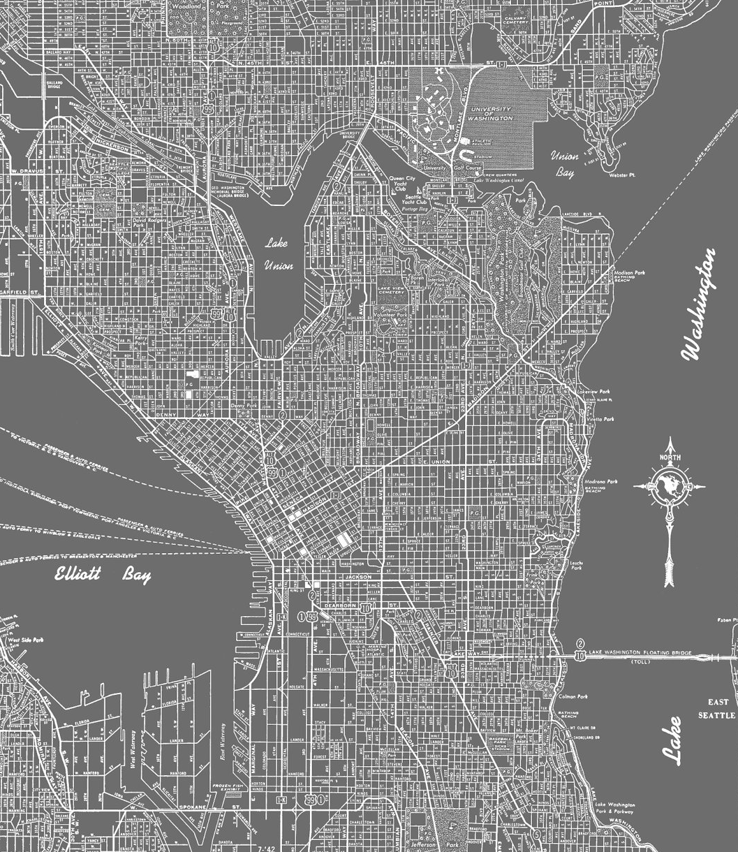

Sample, collection, & preparation
Data was collected between November 2015 and January 2016 utilizing a cloud-based participant recruitment platform called Prolific Academic (prolific.ac) which is similar to Amazon's Mechanical Turk, but built specifically for social science research by social science researchers from the University of Sheffield and backed by the University of Oxford
From a total sample of 1,005 participants, useable data was obtained from 809 participants. Approximately 196 individuals submitted unusable data. Unusable means that resumes were not provided or resumes were not in a format that could be analyzed (e.g. participant submitted a resume in a language other than English).
The survey data was cleaned, string versions of the variables were created, and independent, dependent, and corroboration variables were created.
Resume files were converted into plain text files (.txt)
TO BE DONE
Convert files into dataframe where index is file name and columns contain text
Join text data with survey data file
Text mining stuff…
Notes:
Add additional colors/bolding

Slide 9
Data exploration & diagnostics
Descriptive analytics were done to assess the relative distribution of key data (e.g. task performance or verbal intelligence) across dimensions such as age, education, gender, and tenure. Diagnostics showed that the survey data was normal. These dimensions also provided information necessary to view characteristics of the sample as a whole (most were white, male, with a bachelors degree, an average tenure of 3 years, in entry level IT sector jobs)
The text data were positively skewed and leptokurtic, exhibiting a Zipf’s distribution¹. Most LIWC word categories showed low usage relative to base rates². This is not uncommon with text data. The nature of speech makes this evident—once a phrase or thought is expressed it is usually not repeated and excessive repetition is generally considered bad practice. To mitigate the impact of skew, the data were log transformed³.
An exploration of the word count revealed an even greater number of resume submissions were unusable for the predictive analyses due to low word count. Since the LIWC categories count percentage of each type of word category in a single text, low word count results in inflated and unstable percentage estimates. Thus, resumes with less than 100 words were excluded from the predictive analyses resulting in a sample of 667 participants.
Notes:
Piantadosi, 2015
Pennebaker, et. al., 2015 (LIWC manual)
Tabachnick & Fidell, 2007
Why use the whole sample for correlations: objective here is to see if words related to these corroboration variables and not whether word categories from resumes predicted performance, thus were able to use the whole sample. In addition, correlation is less sensitive to unstable means, compared to OLS regression.
Why 100? 100 words is a conservative estimate, accounting for a range of potential ways for individuals to express themselves in a resume. For example, some are short and function as an illustrative timeline while others are long and detailed.
Why filter on wc: The applied focus of this work and the unstable percentage estimates required it. A purely academic endeavor could have utilized the entire sample, however, this would have limited generalizability because it would include “resumes” that are unlikely to be seen in the real world. It should be noted that most of the shorter resumes were not resumes at all.

Slide 10
Covariates--sex
Notes:
Women reported significantly higher task and contextual performance behaviors than them. Women also reported lower counterproductive behaviors than men, although this difference was not statistically significant.
Note: only covariates with statistically significant relationships with outcome variables are reported here

Slide 11
Covariates--tenure
 | Task Performance | Contextual Performance | Counterproductive Performance (CWB)
Tenure | -.086* | .003 | .011
*p < .05
Notes:
Tenure was negatively correlated with task performance behaviors although this relationship was small

Slide 12
Other covariates not significantly correlated with task, contextual, or counterproductive job performance behaviors
RACE
EDUCATION

Slide 13
THANK YOU!

